Slide 1
Hierarchical Multi-Objective Optimization
BAYESIAN OPTIMIZATION
Chimera scalarization · kernel-density surrogate · acquisition search · adaptive update loop
Internal technical summary

Slide 2
Foundations
BASE PAPERS
Phoenics
Chimera
Gryffin
ACS Cent. Sci., 2018
Chem. Sci., 2018
Appl. Phys. Rev., 2021
Bayesian kernel-density surrogate and acquisition function for continuous-space optimization.
Hierarchy-based achievement scalarization: turns multiple objectives into one merit value.
Extends Phoenics to categorical and mixed spaces; defines the recommend-observe loop we follow.
Our implementation follows these equations directly in pure NumPy — no Cython, PyTorch or MCMC dependency.
Pipeline foundations
1 / 6

Slide 3

Chimera — Hierarchy & Tolerance
STAGE 1 · MULTI-OBJECTIVE TO SINGLE MERIT
Objectives ranked by priority — index 0 matters most
Each objective gets a tolerance: how much it may degrade so the next one can improve
A lower-priority objective only counts once every higher-priority one is within tolerance
EXAMPLE — 5 OBJECTIVES, IN ORDER
P0 — Yield (max)
tolerance 20% of observed range
P1 — Purity (max)
MERIT FORMULA
only counted if P0 passed
chi(x) = F0 * pass0 + sum_k (Fk - best_at_prev_level) * passk * (all earlier failed)
P2 — Cost (min)
only counted if P0, P1 passed
Output: one scalar merit per experiment, normalized to [0,1] (0 = best) and sqrt-sharpened near the optimum.
P3 — Byproduct (min)
only counted if P0–P2 passed
P4 — Stability (max)
lowest priority
Input: Y (n x 5 raw objectives) -> Output: merit (n values) in [0,1]
2 / 6

Slide 4
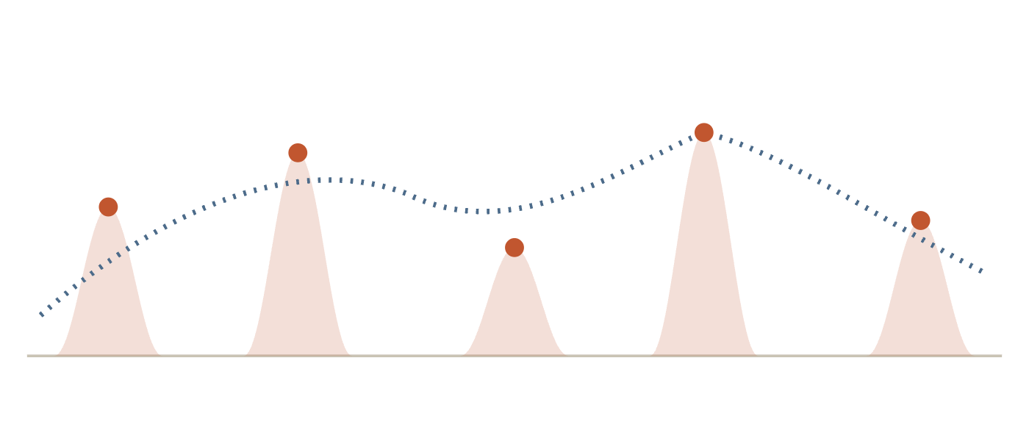
Kernel-Density Bayesian Surrogate
STAGE 2 · LEARN A CHEAP MODEL
One Gaussian kernel is centered at every observed point
Precision (kernel width) grows with the number of observations: tau_n = 12 * n^2
More data means narrower, more confident kernels
KERNEL
p_k(x) = (tau / 2pi)^(d/2) * exp(-0.5 * tau * ||x - x_k||^2)
PREDICTION
predict(x) = sum_k( merit_k * p_k(x) ) / sum_k( p_k(x) )
Each dot is one past experiment. The dashed line is the fitted surrogate curve.
Input: U (n x 7, unit cube), merit (n,) -> Output: surrogate model predicting merit anywhere
3 / 6

Slide 5
Acquisition Function & Lambda
STAGE 3 · DECIDE WHERE TO TRY NEXT
ACQUISITION
lambda = +1 — Exploit
alpha(x) = ( sum_k(merit_k * p_k(x)) + lambda * p_uniform ) / ( sum_k(p_k(x)) + p_uniform )
Unexplored regions look artificially bad. Search concentrates near the current best point.
Lambda sweeps from +1 (exploit) to -1 (explore) across the requested proposals
Near existing data, alpha is close to the surrogate's prediction
Far from all data, alpha collapses toward lambda itself
lambda = -1 — Explore
Unexplored regions look artificially great. Search is pushed toward unseen areas of the space.
Input: surrogate model + lambda -> Output: acquisition surface alpha(x) over the unit cube
4 / 6

Slide 6

Optimizing The Acquisition — Adam
STAGE 4 · SEARCH THE SURFACE
1
2
3
4
Global search
Keep the best
Refine with Adam
Diversity filter
Sample ~2000 random points across the unit cube; evaluate alpha on all of them at once
Shortlist the ~10 candidates with the lowest acquisition value
Walk each candidate downhill using alpha's exact gradient, ~60 steps
Drop a candidate that lands too close to one already chosen this round
Input: acquisition surface alpha(x) -> Output: next experiment(s), x* in real units
5 / 6

Slide 7
Closing The Loop — Model Update
STAGE 5 · LEARN FROM THE RESULT
1
2
3
4
Recommend
Experiment
Append
Refit
Propose x* from the current observation history
Run the real experiment at x*, measure all 5 targets
Add the new (x*, y) pair to the observation list
Rebuild the Chimera merit and the surrogate from scratch on the full history
The optimizer is stateless between calls: every recommend() call re-derives the merit and the surrogate from the ENTIRE observation history, not just the newest point.
n observations -> n+1 after each round -> repeat
Input: new (x*, y) pair -> Output: updated observation list, ready for the next round
6 / 6

